Slide 1

Further Communication Protocols
Technology Solution Center (F. LCS)
.
Simon WANG & Zita PAN
2020.04

Slide 2








Detection
Detection
Email

Slide 3
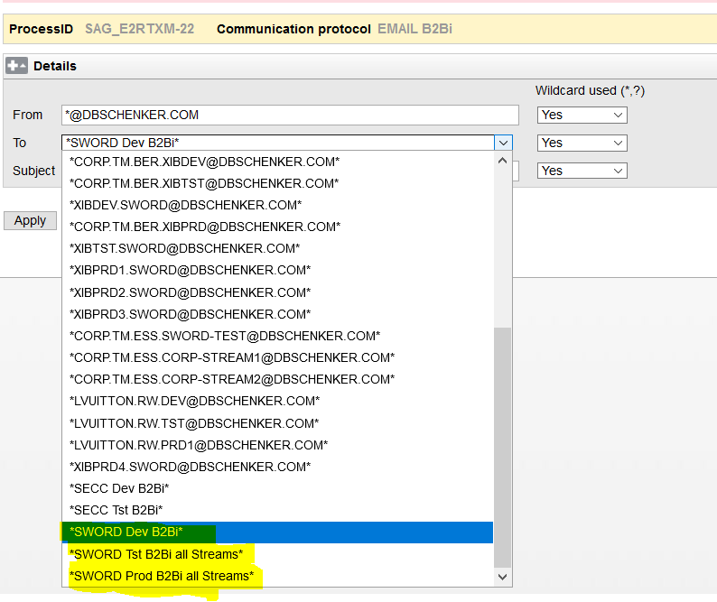
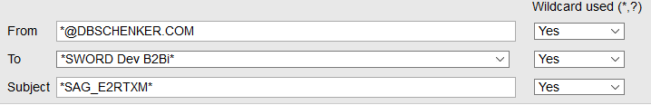

Email B2Bi
Tips
From: *@dbschenker.com
To: DEV, TEST PROD
  DE.TM.ESS.B2BIDEV.SWORD@DBSCHENKER.COM
  DE.TM.ESS.B2BITST*.SWORD@DBSCHENKER.COM
  DE.TM.ESS.B2BIPRD*.SWORD@DBSCHENKER.COM
Subject: Usually should be PID with *
Email detection is ALWAYS needed from DEV and TEST
Pay attention to Wildcard

Slide 4
Email B2Bi
Environment | Email Address
DEV | DE.TM.ESS.B2BIDEV.SWORD@DBSCHENKER.COM
TEST Parallel 1A | DE.TM.ESS.B2BITST1.SWORD@DBSCHENKER.COM
TEST Parallel 2A | DE.TM.ESS.B2BITST2.SWORD@DBSCHENKER.COM
PROD Parallel 1A | DE.TM.ESS.B2BIPRD1.SWORD@DBSCHENKER.COM
PROD Parallel 2A | DE.TM.ESS.B2BIPRD2.SWORD@DBSCHENKER.COM
PROD Parallel 1B | DE.TM.ESS.B2BIPRD3.SWORD@DBSCHENKER.COM
PROD Parallel 1C | DE.TM.ESS.B2BIPRD4.SWORD@DBSCHENKER.COM
PROD Parallel 1D | DE.TM.ESS.B2BIPRD5.SWORD@DBSCHENKER.COM
PROD Parallel 1E | DE.TM.ESS.B2BIPRD6.SWORD@DBSCHENKER.COM
PROD Parallel 1F | DE.TM.ESS.B2BIPRD7.SWORD@DBSCHENKER.COM

Slide 5
MQ B2Bi
  What is MQ?
  WebSphere MQ or often "MQ".
  Message Oriented Middleware offered by IBM.
  Why MQ?
  Allows independent and potentially non-concurrent applications on a distributed System to communicate with each other.
  Designed for application-application data exchange.
  Independent on operating system, programming language or network protocol.
  Transaction orientated, very reliable, fast.

Slide 6
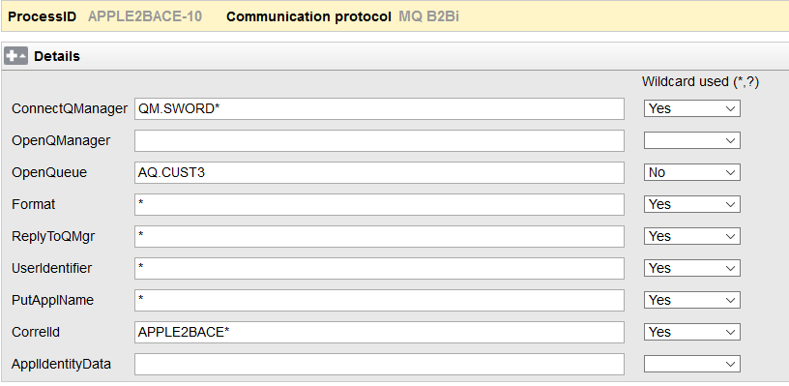
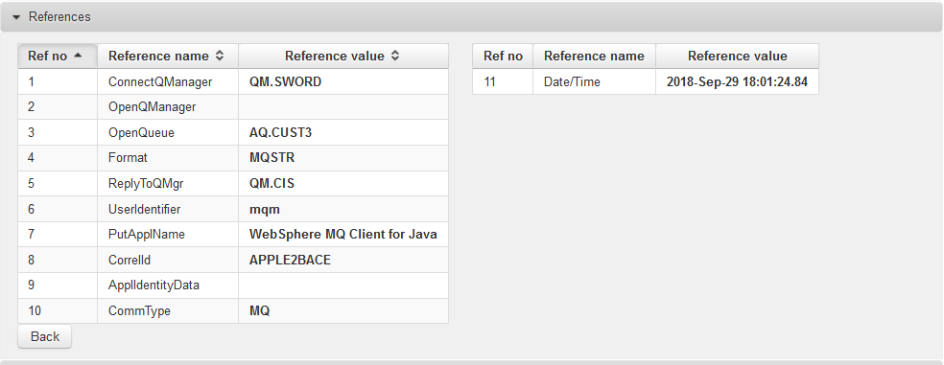
MQ B2Bi
MQRuntimeReceiveInfo {6126,"QM.SWORD","","AQ.CUST3","AMQ QM.CIS [\376v\373!\fD\356","APPLE2BACE\000\000\000\000\000\000\000\000\000\000\000\000\000\000",8,0,-1,0,273,1208,"MQSTR",4,1,"QM.CIS","","mqm","","",28,"WebSphere MQ Client for Java","20181130","17004461","","LQ.CUST3","","",0,0}
Tips
OpenQueue is given in spec.
If not, then use AQ.*CUST*
For Correlld: Always add * after PID
For ConnectQManager: Always use QM.SWORD* for both TEST and PROD environment.

Slide 7
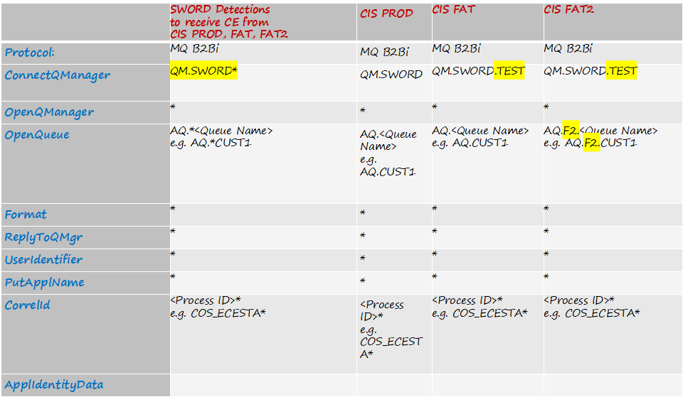
MQ B2Bi

Slide 8
MQ B2Bi
Tips
There are 8 queues between CIS and SWORD
If a process uses Queue 1, Queue5 and Queue 6, it should run on Parallel1A (AQ.CUST1, AQ.CUST5, AQ.CUST6)
If a process uses Queue 2 and 3, it should run on Parallel2A (AQ.CUST2, AQ.CUST3)
Queue 4 and Queue 7 are not used

Slide 9
AS2 B2Bi
Definition
AS2: security is achieved by using digital certification, signature and encryption.
Has two kinds of acknowledgements (MDNs) which are Synchronous and Asynchronous.
AS2 includes an MDN signal to confirm whether receiver receives correct file.
AS2 MDN package is sent back to sender when Interchange receives EDI file.
AS2 only has 1 single way for confirmation of receipt and NO business confirmation.

Slide 10
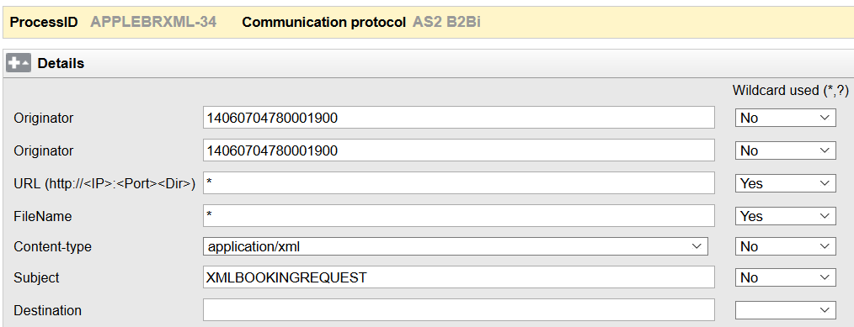
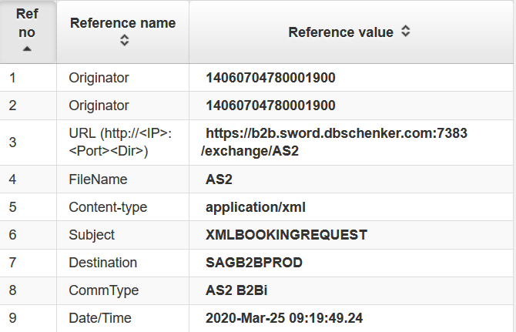
AS2 B2Bi

Slide 11
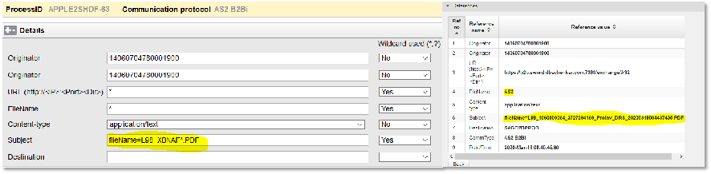

AS2 B2Bi
Tips
  In some circumstance, the filename is always “AS2” and the actual filename is in subject part.
  E.g. Some of the APPLE (CORP) process with AS2 detection - APPLE2SHDF
  In this case, do remember to use KEY VALUE 6 as original filename when fetch reference

Slide 12
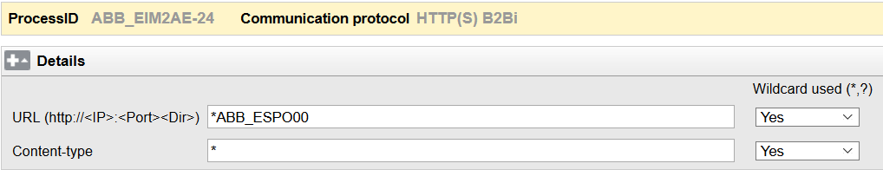
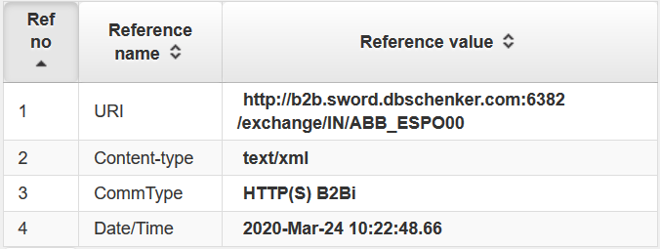

HTTP(S)
Tips
The URL is https://b2b.sword.dbschenker.com:6382/exchange/IN/<SWORD-process-ID>

Slide 13
OFTP V2 B2Bi
Definition
OFTP: It comes from the Odette-Organisztion (org for data exchange by tele transmission in Europe), only used in Europe, limited for cars: Porsche.
OFTP2: Session level encryption, File level encryption, Secure authentication, Certificates and File compression. Has signed negative end response . Works over TCP/IP standard port 6619, ISDN and X.25. Software needed (licenses).
OFTP2 is newer version of OFTP protocol. It supports the transfer on the Internet and it uses Integrator to identify the valid trading partner.

Slide 14
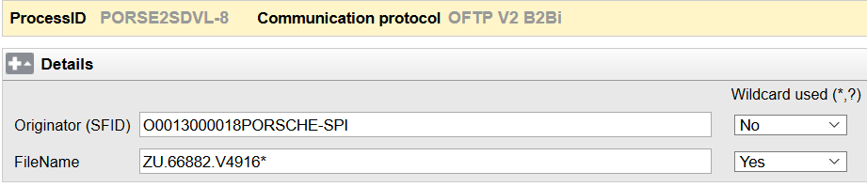
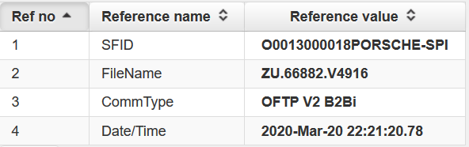
OFTP V2 B2Bi

Slide 15
RN B2Bi
Definition
The RosettaNet standard defines both e-commerce document and exchange protocols, as part of the Electronic data interchange (EDI).
The RosettaNet standard is based on XML and defines message guidelines, interfaces for business processes, and implementation frameworks for interactions between companies. Mostly addressed is the supply chain area, but also manufacturing, product and material data and service processes are in scope.
https://www.edibasics.com/edi-resources/document-standards/rosettanet/

Slide 16
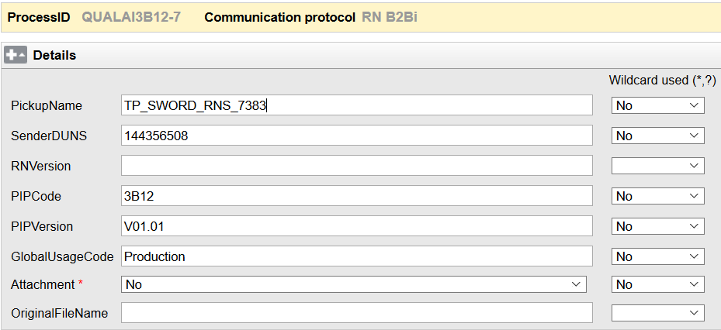
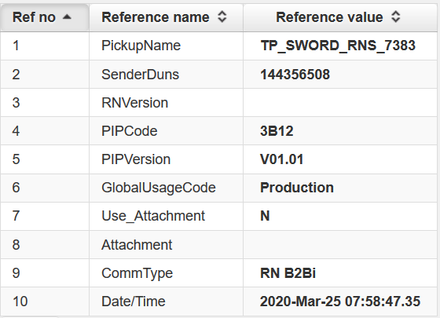
RN B2Bi

Slide 17
JMSClient B2Bi
Information
Use them all the time to process long-running operations asynchronously. A web user won't want to wait for more than 5 seconds for a request to process.
Asynchronous transactions that are exchanged using either publish channels or enterprise services, use Java Message Service (JMS) queues to exchange data with an external system.
https://www.ibm.com/support/knowledgecenter/en/SSLKT6_7.6.0/com.ibm.mif.doc/gp_intfrmwk/c_jms_queue_configuration.html
IBM knowledge center

Slide 18
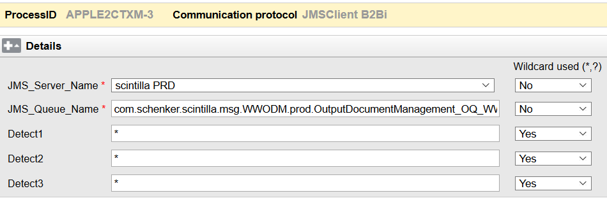
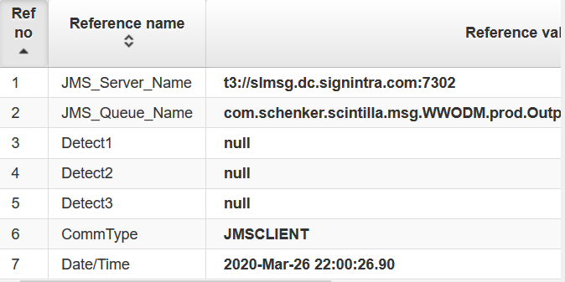

JMSClient B2Bi
Tips
Take care of the JMS_Server_Name :
Test – scintilla FAT(t3://slmsg-fat.dc.signintra.com:7302)
PROD – scintilla PRD(t3://slmsg.dc.signintra.com:7302)
JMS_Queue_Name is the JNDI Queue Name

Slide 19
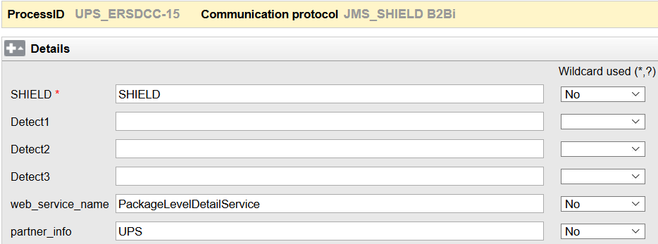
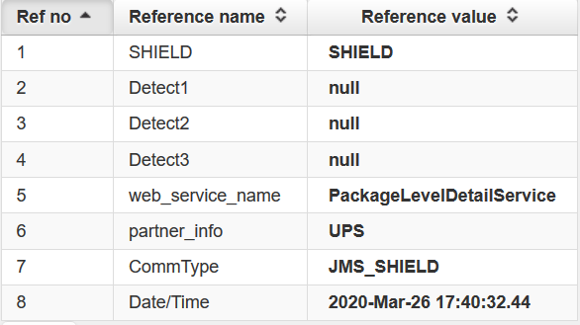

JMS_SHIELD B2Bi
Tips
FileName: msg_ID#api-back-11-i-0aaf91e49489dd469.prd.schenkerag.de.
axway.cloud-40134-1543356303791-2342#1#12#24213#1.arc
Sometimes the filename might be stored in JMSHeader which will be copied into GenAtt, use bracket code to get it.

Slide 20
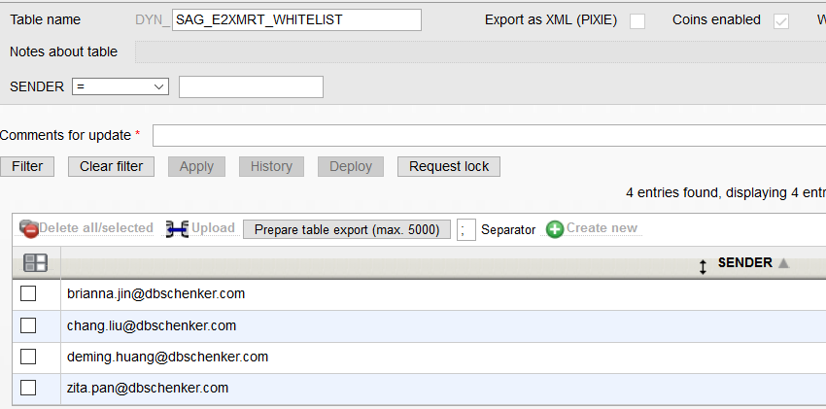
Email Whitelist
How to allow files from specific senders?
How to block files from specific email senders?
Step1
Create a dynamic table
Only one columns which will be filled in with e-mail addresses.
e.g. DYN_SAG_E2XMRT_WHITELIST

Slide 21
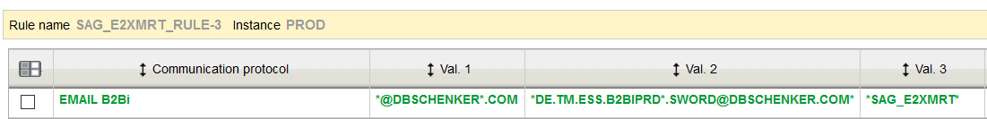
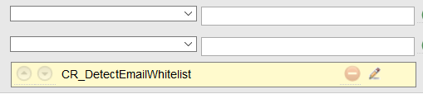

Email Whitelist
Step2
2. Create a new rule
In "Manage rules", create a new rule, select "Incoming communication" with "EMAIL B2Bi".
Fill in "Detection" as usual.
Click "Process Step", select "CR_DetectEmailWhitelist", edit it and add the new table's name.
eg. SAG_E2XMRT_RULE

Slide 22
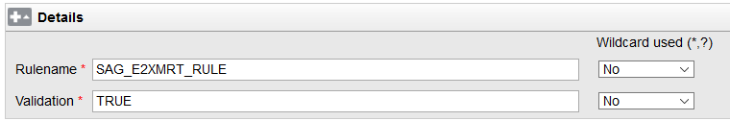
Email Whitelist
Step3
3. Add detection for a process
Select “Communication protocol” “EMAIL_WHITELIST”.
Fill the “Rulename” with the one you created
Fill the “Validation” field:
(1）IF “TURE”, then allow specific senders in the table to send files
(2) IF “FALSE”, then block specific senders in the table to send files
If you create a TEST RULE with your own test PID
Do remember to deactivate the RULE after testing
Otherwise, you will face SYSTXERROR (the email will be fetch for both rule and the test PID)

Slide 23






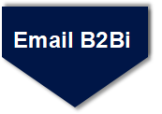
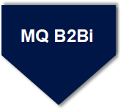
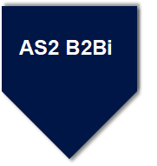
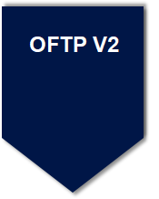
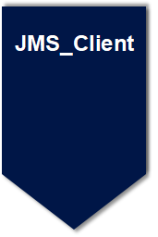
Routing Code
JMS_SHIELD

Slide 24
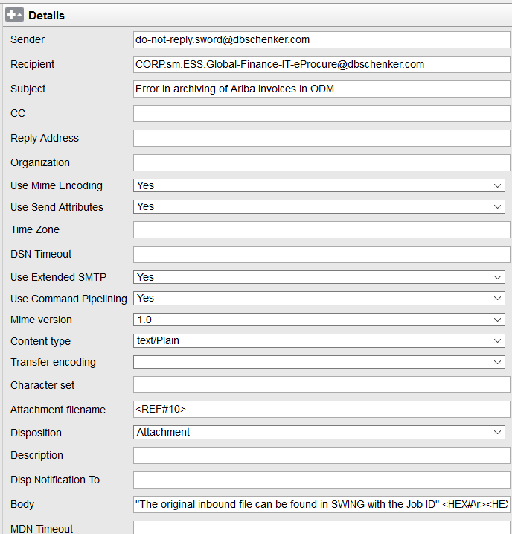
Email B2Bi
1
2
3
Tips
4
Use “,” if there are multiple receivers
The email address MUST be valid
Otherwise error will occur
Support bracket code:
<REF#10>
<DATE#%Y%m%d%H%M%S>
<C#CNT,3>
5
6

Slide 25
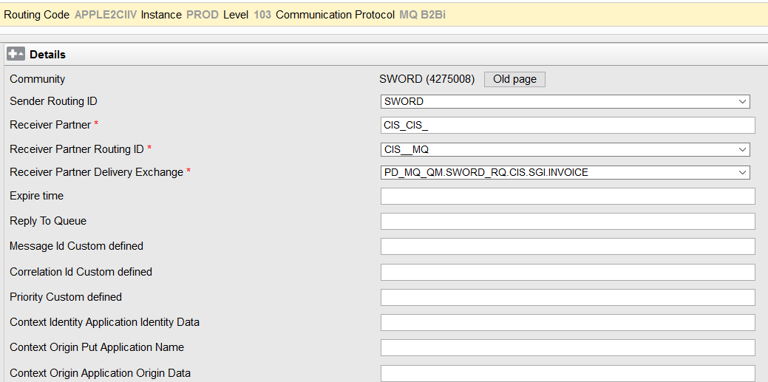
MQ B2Bi
1
Tips
Sender Routing ID: SWORD
Receiver Partner (mention in the documentation)
Receiver Partner Routing ID (as above)
Receiver Partner Delivery Exchange (as above)
2
3
4
5
6

Slide 26
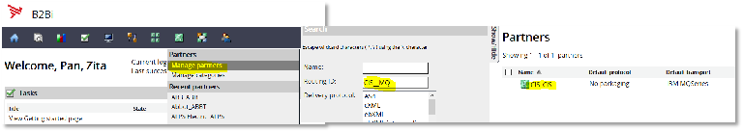
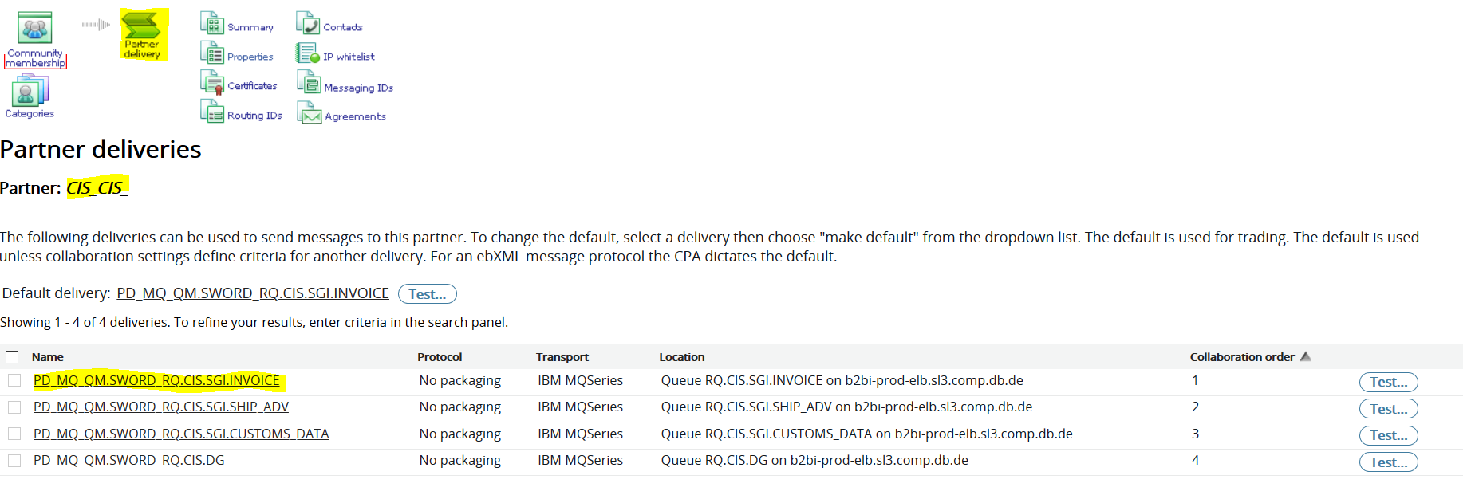
MQ B2Bi
1
You can also check the corresponding information on our B2Bi GUI
2
3
4
5
6

Slide 27
AS2 Outbound Flow (Successful one)
Internal client
1
2
FTP server
comsys
3
Trading partner
6
XSR
5
Interchange
Integrator
4
7
8
9
Orange color :MDN
Blue color : File transmit

Slide 28
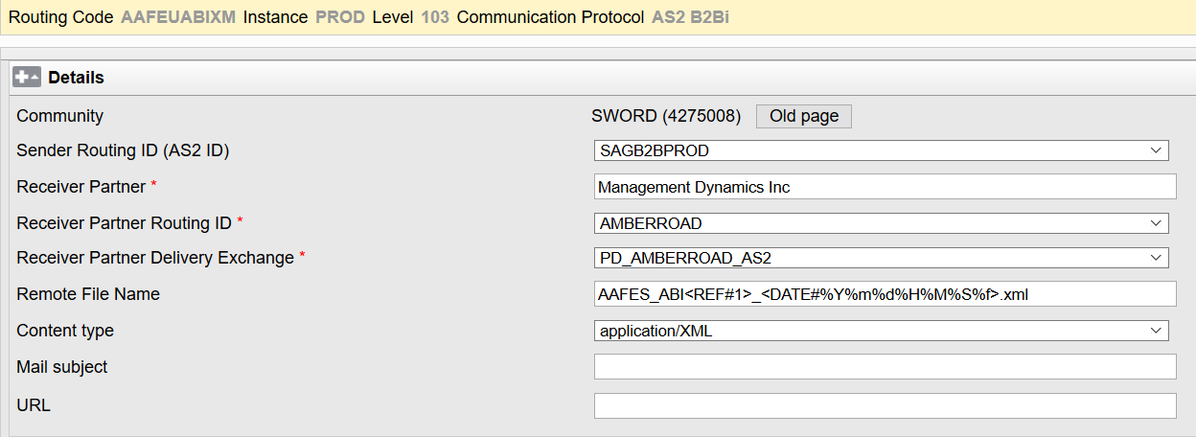

AS2 B2Bi
1
2
3
4
5
Tips
Receiver Partner, Routing ID and Delivery Exchange information is created by OPS team.
Normally the format of Delivery Exchange value is PD_<Routing ID>_AS2
6

Slide 29
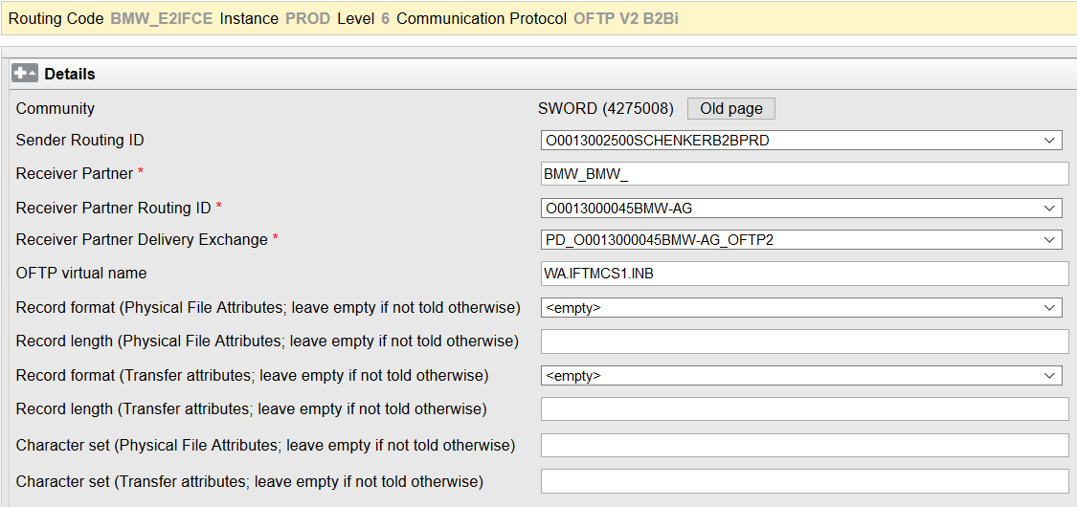

OFTP V2 B2Bi
1
2
3
4
5
Tips
6
Receiver Partner, Routing ID and Delivery Exchange information is created by OPS team.
Normally the format of Delivery Exchange value is PD_<Routing ID>_OFTP2

Slide 30
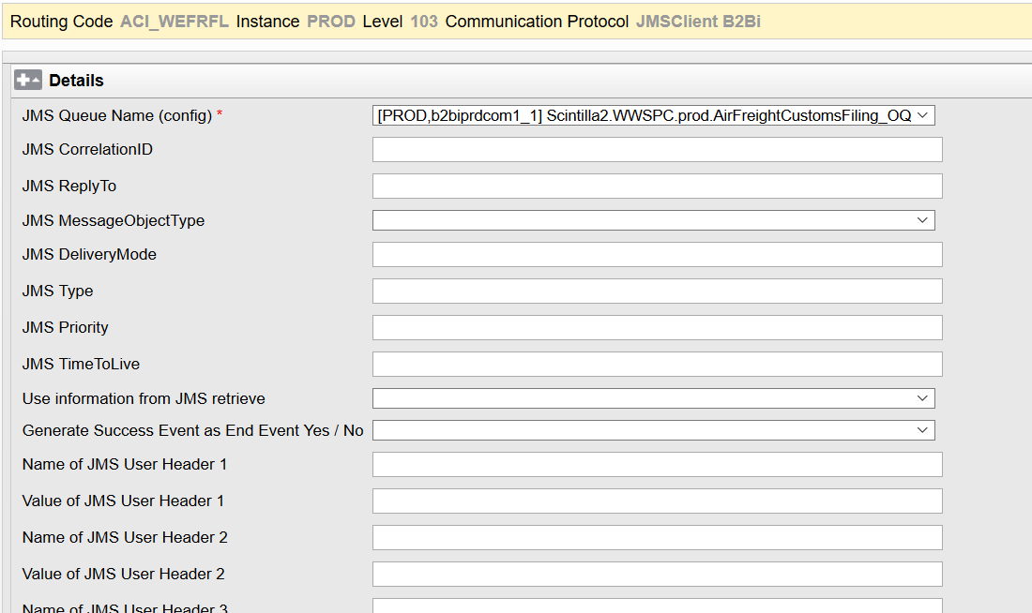
JMSClient B2Bi
1
2
3
4
5
6

Slide 31
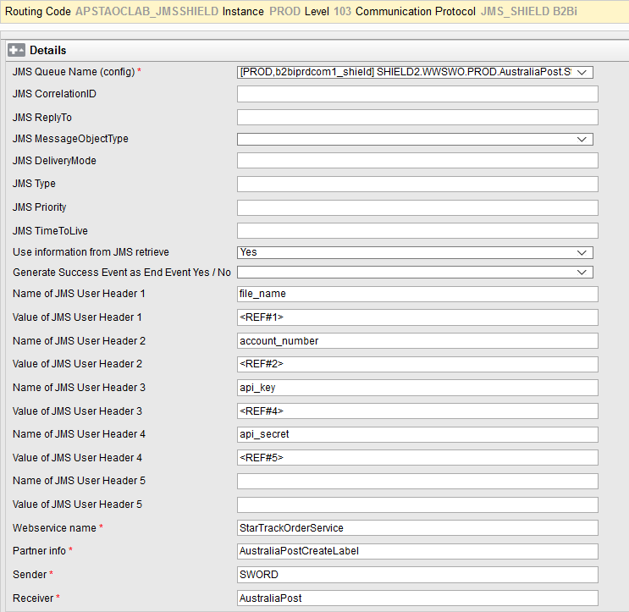
JMS_SHIELD B2Bi
1
2
3
4
5
6

Slide 32


Thanks for your attention

